Slide 1
Tutorial 1 Learning Topology Optimization Through Examples and Case Studies
August 18, 2019

Slide 2
FEA for Topology Optimization

Slide 3
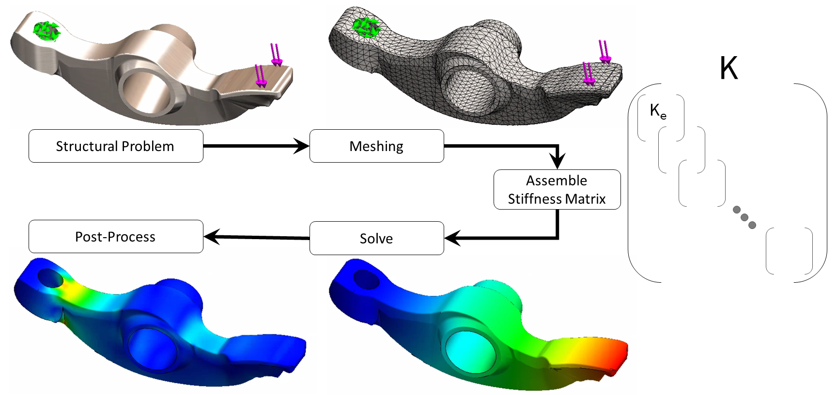
FEA

Slide 4
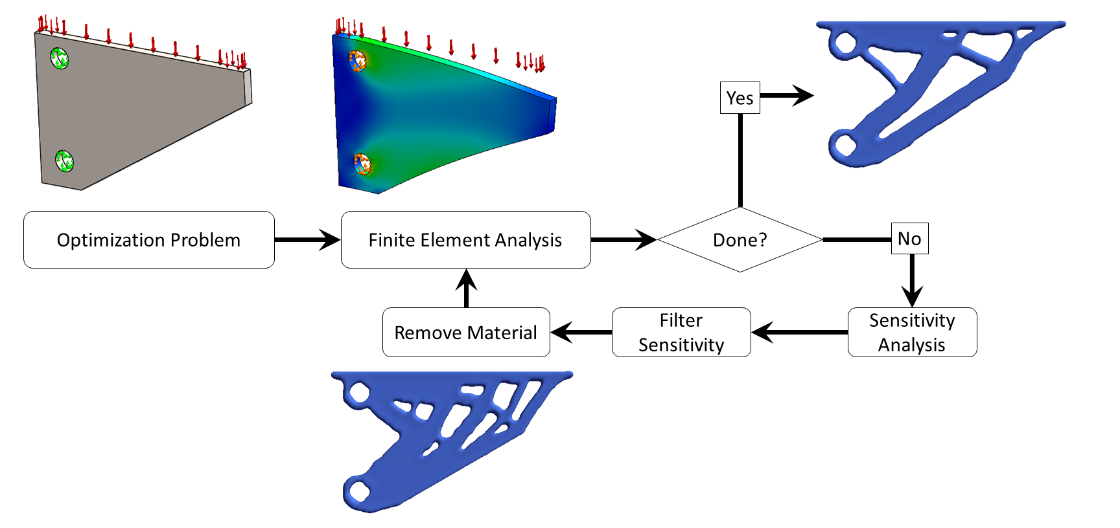
TopOpt relies on FEA

Slide 5
FEA for TopOpt
Can use any generic FEA engine … but
Robust
Fast
Scalable
(Sufficiently) accurate
Customized FEA engine can help accelerate topopt!

Slide 6
FEA

Slide 7
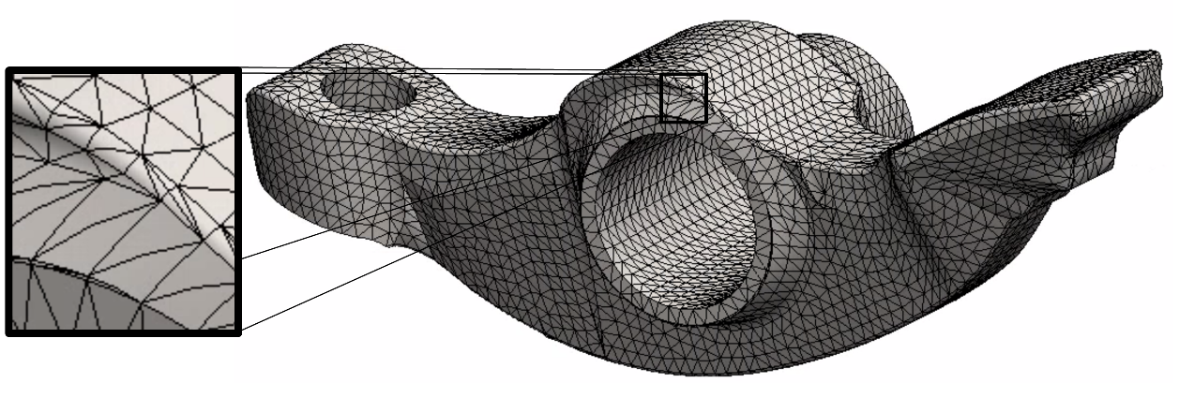
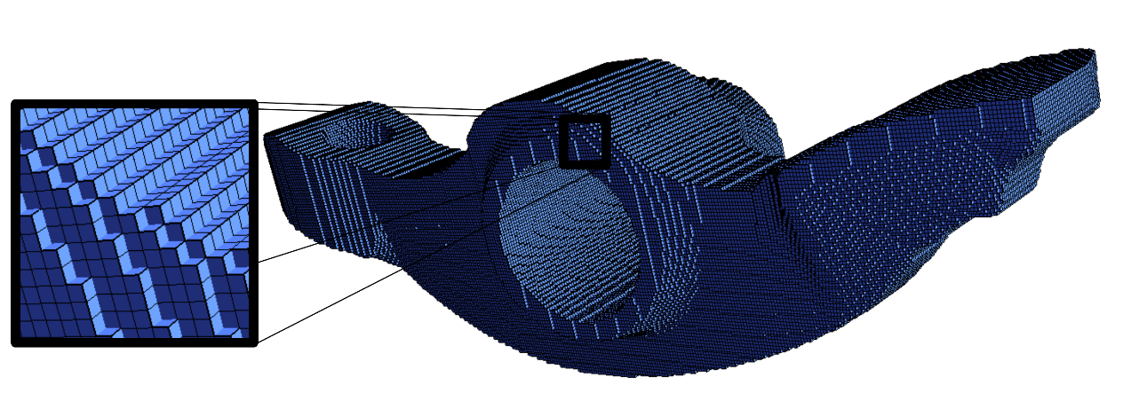
FEA for TopOpt: Meshing
Classic mesh (tet-mesh)
Conforms to geometry
Accurate
Slow
Not robust
Not scalable
Change in topology?
Voxel mesh
Fast
Robust
Highly scalable
Fast FEA
Accuracy?
Stress smootheners used in topology optimization.

Slide 8
FEA

Slide 9
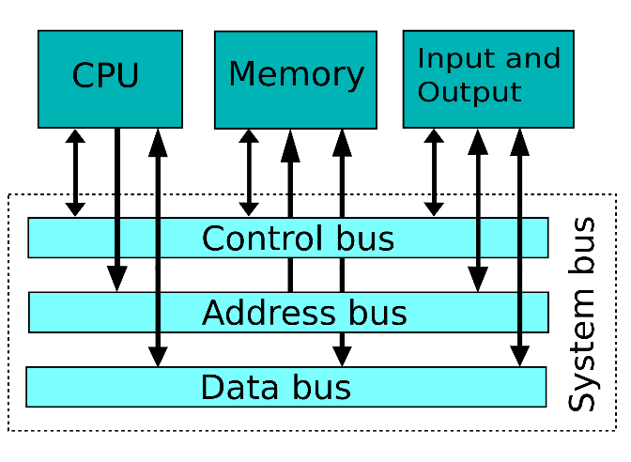
Bottleneck: Memory Access
Design
Space
FEA
Done?
Change Topology
No
[“The End of Error: Unum Computing”, Gustafson, CRC Press,2015]

Slide 10
Methods
Direct
Robust but memory hungry

Slide 11
Methods
Direct
Iterative
(Conjugate gradient)
Strengths
Simple
Scalable
Challenges
Fast SpMV Kd
Good preconditioner

Slide 12
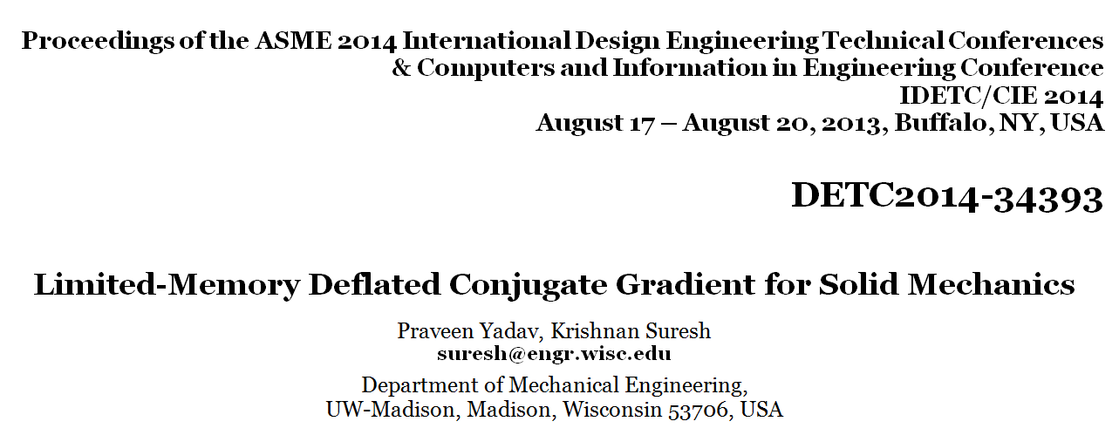
Details in Publication

Slide 13
Experiment
Assembled Kd
770
10⁶ Elements
1 Distinct
Assembly-free Kd
37
3.8
Identical result
Reduced memory
CPU

Slide 14
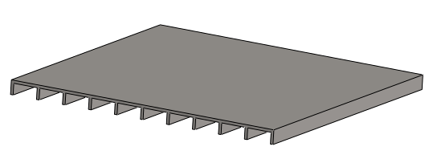
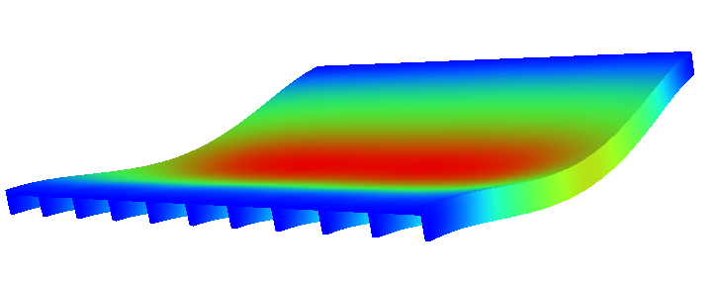
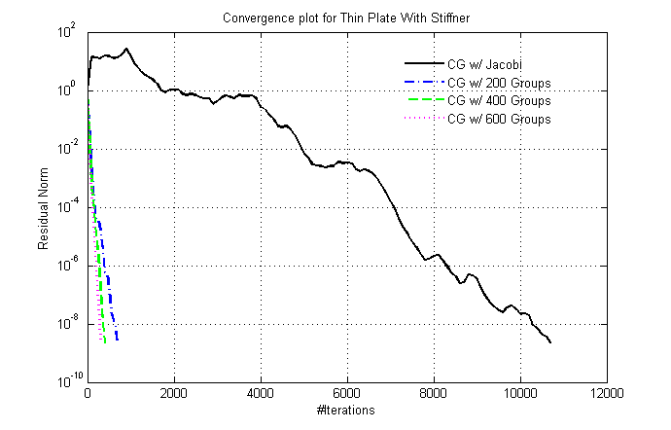
Thin Solid: Iterations
3.15 million DOF

Slide 15
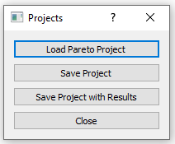
Lens Mount
Load project
Navigate to the ParetoExamples folder
Select LensMountProject.prj

Slide 16
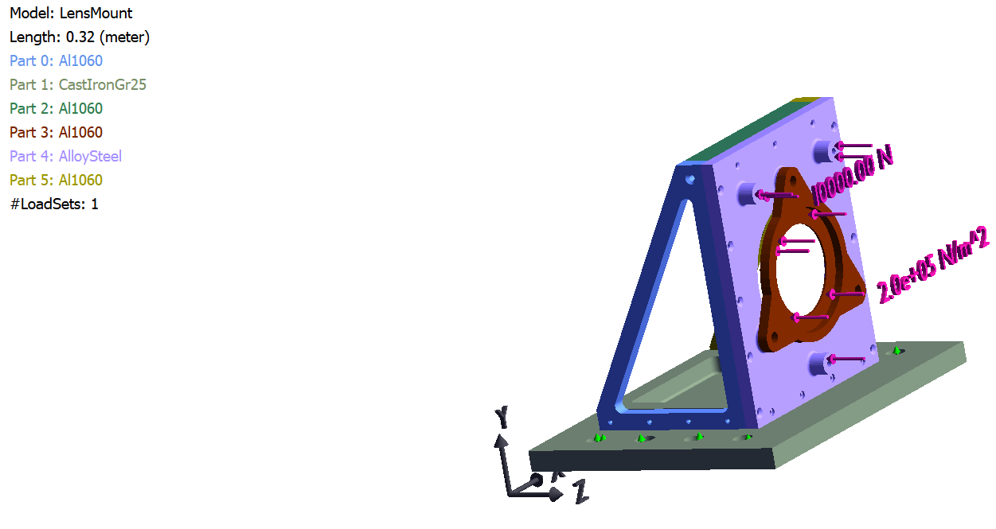
Lens Mount

Slide 17
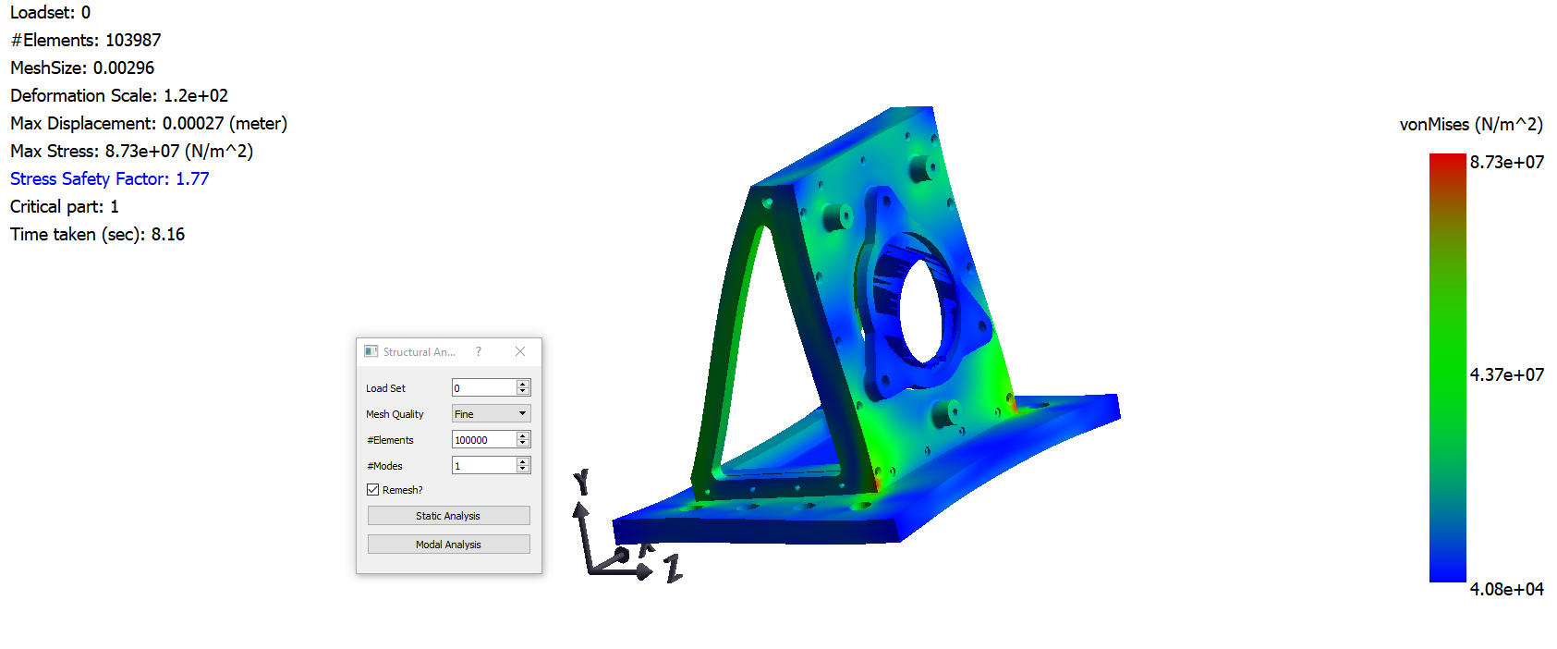
FEA

Slide 18
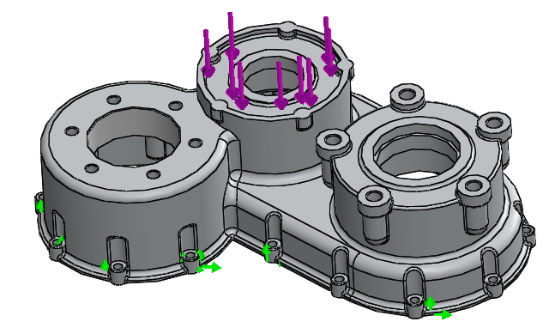
Assembly-Free FEA
1 million elements
83 seconds

Slide 19
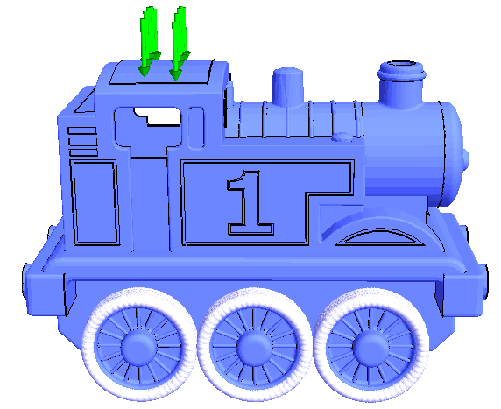
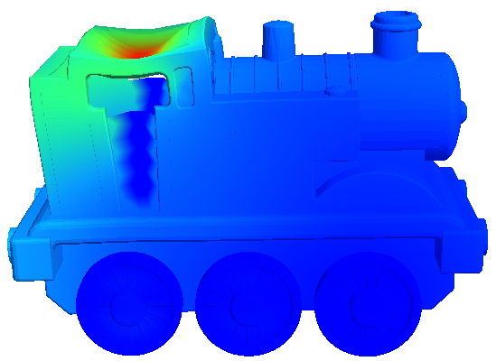
Large-Scale Static Analysis
50 million DOF
CPU
4 hours
GPU
24 minutes

Slide 20
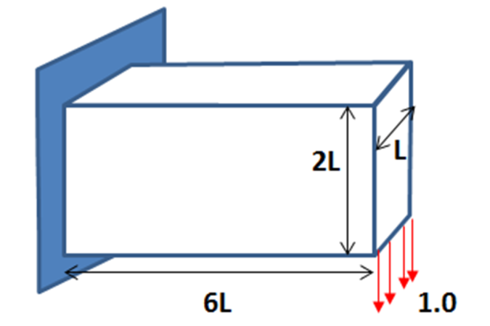
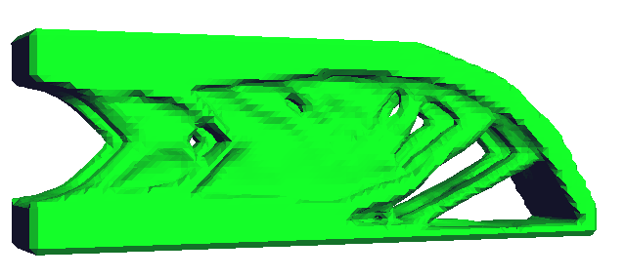
Example: Design Optimization
Commercial topopt
Xeon E5 2697, 92 GB
20 hours!
Pareto
I7 4770, 8 GB
42 mins

Slide 21
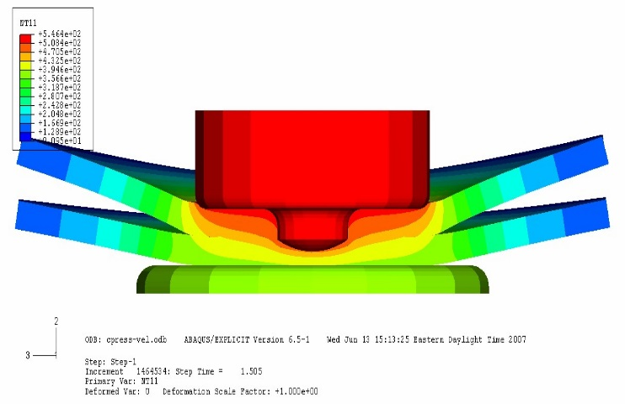
Friction Stir Welding
Transient
Thermo-Elastic Simulation
Mirzendehdel, A. M., Suresh, K., “A Deflated Assembly Free Approach to Large-Scale Implicit Structural Dynamics,” J. Comput. Nonlinear Dynam., 10(6), doi: 10.1115/1.4029110, 2015

